Slide 1
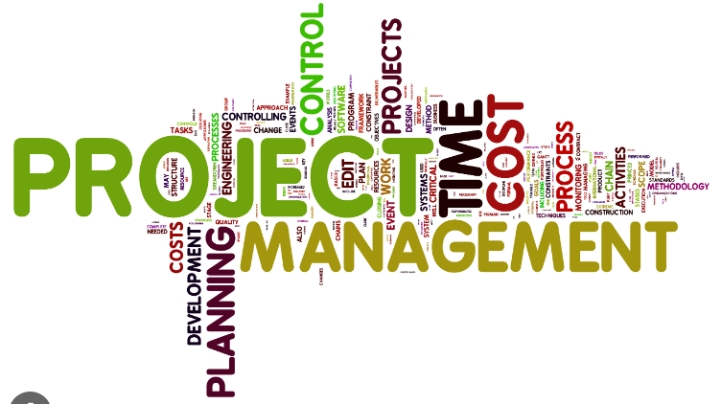
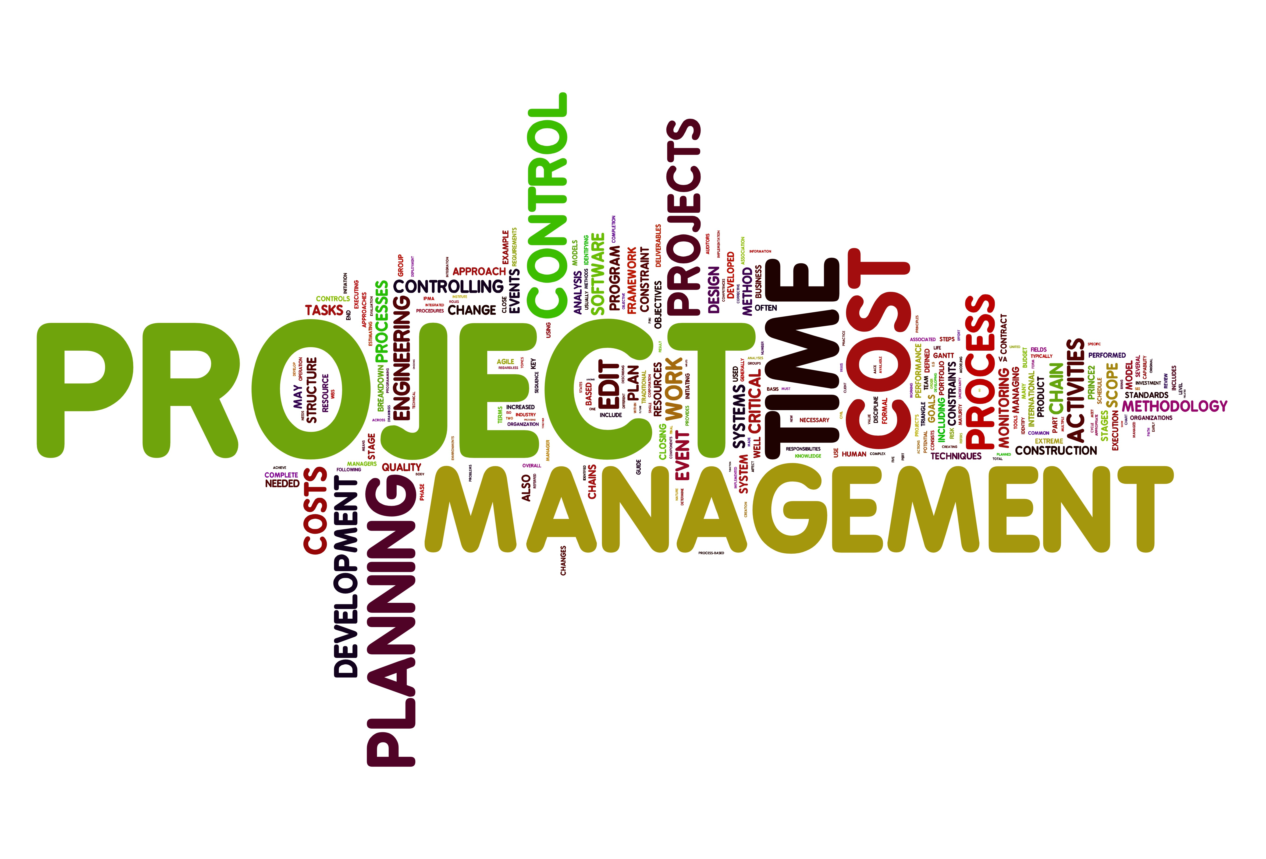
Software Project Management
Lecture 1
Sarah Mazhar

Slide 2
Why it was needed to have Project management…
Why it was needed to do Project Management in Software Industry
Project Management
Software Engineering
Software
Project Management
……………….
Project Management
…………….
Analysis
Development
Business Project Management
Engineering Project Management
Design

Slide 3
Software Crises
The term "software crisis" refers to a period in the history of software development when there were significant challenges and issues in producing software systems.
It was coined in the early days of computing when the limitations of available technology, methodologies, and practices became apparent.

Slide 4
All the failed projects or projects with delays and cost overruns make the history collectively termed Software Crises.
It cannot be said that Crises happened in history and now it is over. Crises still happens.

Slide 5
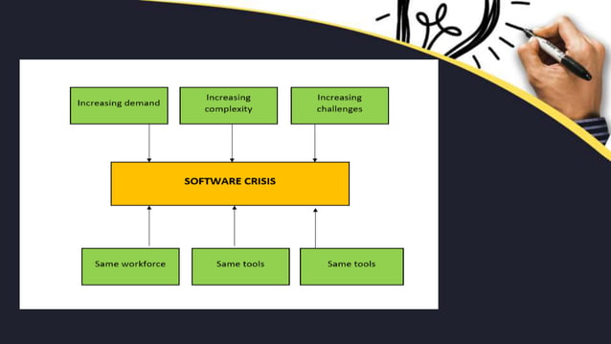

Slide 6
If same workforce, same methods and same tools are used after fast increase in software demand, software complexity and software challenges, then some problems arise like budget, quality, time management etc. which may collectively be termed as Software Crises

Slide 7
The software crisis is characterized by several key challenges and problems:
Complexity: Software systems were becoming increasingly complex, making them difficult to design, develop, and maintain. This complexity led to challenges in understanding, managing, and controlling software projects.
Cost Overruns: Software projects often exceeded their initial budgets and schedules. This was partly due to the underestimation of the effort required to develop software and the lack of effective project management practices.
Schedule Delays: Software projects frequently missed their deadlines, causing frustration for both developers and users. Delays were often caused by changing requirements and the challenges of coordinating development efforts.

Slide 8


Buggy Software: Software quality was a major concern. Many software systems were delivered with numerous defects and errors, leading to reliability and usability issues.
Inadequate Tools and Methodologies: Early software development lacked the tools, methodologies, and best practices that are commonplace today. Developers had to rely on manual processes and ad-hoc methods.
Rapid Technological Change: The field of computing was evolving rapidly, and software development struggled to keep pace with hardware advancements. This made it challenging to develop software that could fully leverage new technologies.
Lack of Formal Processes: There was a lack of formalized software development processes and standards. This resulted in inconsistency and unpredictability in software projects.

Slide 9
About US$250 billions spent per year in the US on application development
Out of this, about US$140 billions wasted due to the projects getting abandoned or reworked; this in turn because of not following best practices and standards
Standish Group
The Standish Group is a well-known research and advisory organization specializing in information technology (IT) and software-related research. It is particularly famous for its "CHAOS Report" series, which focuses on the success and failure rates of IT and software projects.

Slide 10
Solution to Software Crises
As the software is ever-changing, best practices also change. The cumbersome practices are not solutions to new problems so the solution is also not definite…… it is changing.
The good thing about the software crisis is it prompted the development of new approaches and methodologies to address these challenges.
One significant response was the emergence of structured programming, software engineering principles, and later, the adoption of agile, iterative development practices and especially Software Project management.
These changes helped to mitigate many of the issues associated with the software crisis.

Slide 11
“Project”
A project is a temporary endeavor undertaken to create a unique product, service, or result.
Attributes:
Temporary: Projects have a defined start and end date.
Unique: Each project has specific objectives and deliverables that distinguish it from other work.
Goal-Oriented: Projects are undertaken to achieve a specific goal or outcome.
E.g. Developing a new software application, constructing a building, organizing an event.

Slide 12
“Process”
A process is a series of structured, repeatable activities designed to produce a specific output or result.
Attributes:
Ongoing: Processes are continuous and repeatable.
Standardized: They follow established procedures and workflows.
Output-Focused: Processes are designed to produce consistent results.
E.g. Quality assurance processes, procurement processes, change management processes.

Slide 13
“Program”
A program is a collection of related projects and activities managed and coordinated together to achieve strategic objectives.
Attributes:
Multiple Projects: Programs encompass several interrelated projects.
Strategic Alignment: Programs align with an organization's strategic goals and objectives.
Centralized Management: They are managed as a whole to maximize benefits and optimize resource allocation.
E.g.: Implementing an enterprise-wide IT system that includes multiple projects like software development, hardware acquisition, and user training.

Slide 14
Portfolio
A portfolio is a collection of programs, projects, and other work that is grouped together for strategic management and decision-making purposes.
Attributes:
Broad Scope: Portfolios encompass a wide range of programs, projects, and initiatives.
Strategic Alignment: They align with an organization's strategic plan and priorities.
Prioritization: Portfolios involve the selection and prioritization of programs and projects to achieve the organization's objectives.
E.g. An organization's portfolio might include multiple programs and projects across various departments, such as IT projects, marketing campaigns, and product development efforts.

Slide 15
In summary, project management involves different levels of work and management:
A project is a specific, temporary effort to achieve a unique outcome.
A process is a repeatable set of activities aimed at producing consistent results.
A program is a collection of related projects managed together to achieve strategic objectives.
A portfolio is a strategic grouping of programs, projects, and other work to align with organizational goals and priorities.
Understanding these distinctions is essential for effective project management and organizational decision-making.

Slide 16
Software project management- Definition
Software project management is a specialized field of project management that focuses on planning, executing, monitoring, and controlling software development projects.
It involves a range of activities aimed at delivering high-quality software products within the constraints of time, budget, and scope.

Slide 17
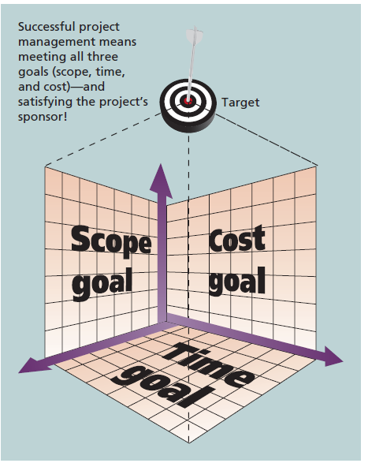
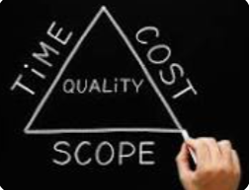
Triple Constraints of Project Management
According to the Triple Constraints of Project Management, the project's costs, time, and scope all impact its success.
A project manager is the one who can maintain control of the triple constraints by balancing these three constraints via tradeoffs.

Slide 18
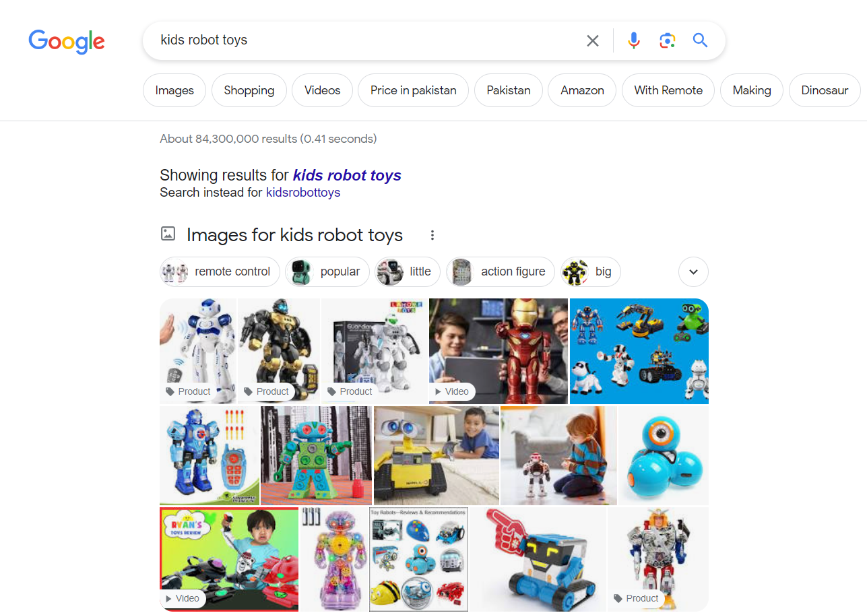
Importance
Effective project management can lead to increased productivity (project completed successfully), quality (meeting their intended goals), and customer (stakeholders) satisfaction.
How are software project goals achieved?
Teamwork
Project Goals Achievement
Communication
Problem-solving
A software Project- Search Engine

Slide 19
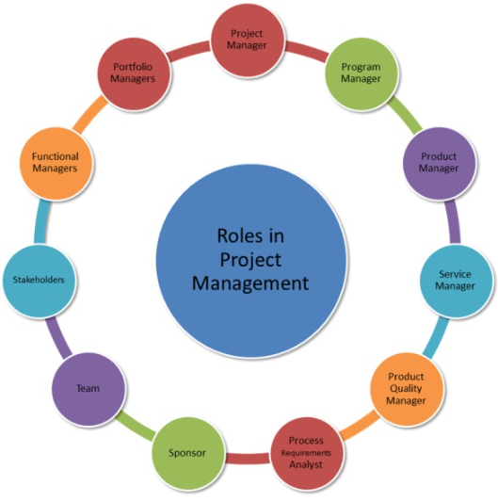
Roles in Project Management

Slide 20

A Project Manager
Being a Project Manager is like being an artist, you have the different colored process streams combining into a work of art.” – Greg Cimmarrusti

Slide 21
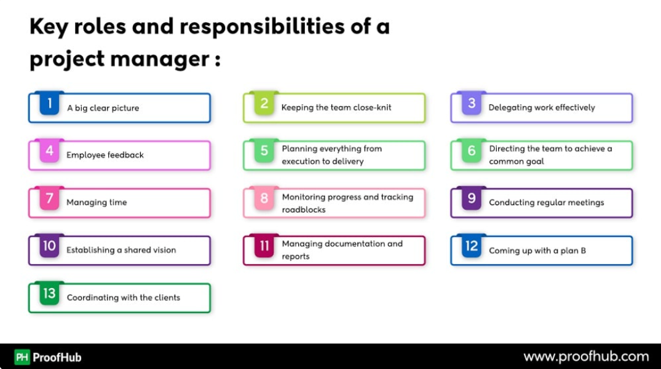
Role and responsibilities of Project Manager
For reading about each role …visit the URL
https://www.proofhub.com/articles/project-manager-roles-responsibilities

Slide 22
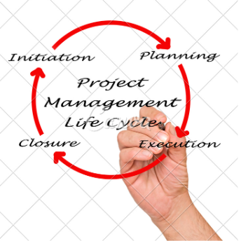
Project Management Life Cycle
The software project management life cycle consists of five stages:
Initiation, Planning, Execution, Monitoring and Control, and Closure.

Slide 23

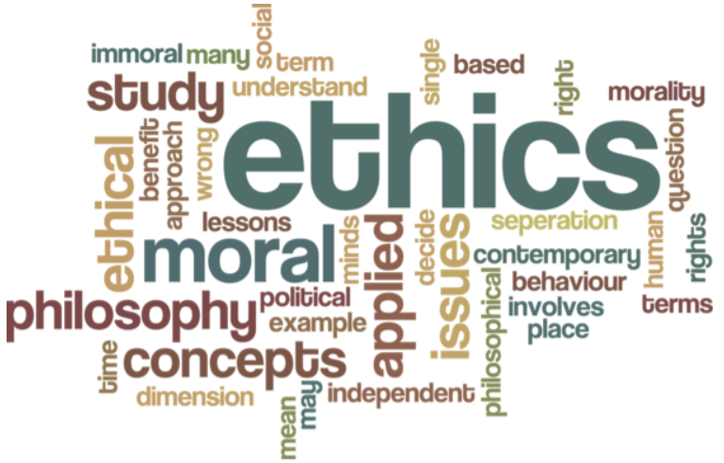
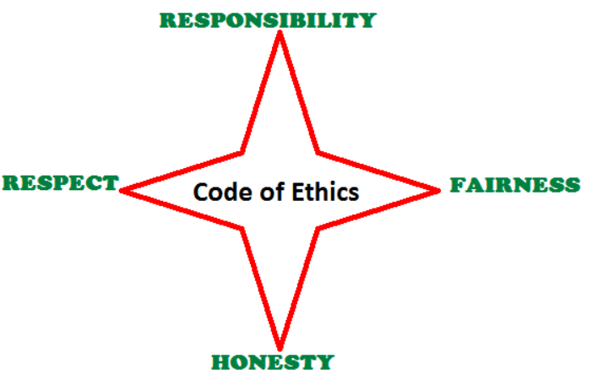

Project Management Ethics
Ethics in project management are certain beliefs about what is morally acceptable or appropriate.
It comprises the values of responsibility, honesty, respect and fairness.
These four core values are central to the project management profession and must be adhered to by project management professionals.

Slide 24
Project Management Certifications
Project management certifications are valuable credentials that demonstrate a professional's expertise and competence in the field of project management.
They are often sought after by individuals looking to advance their careers in project management or related roles.

Slide 25
Here are some well-known project management certifications:
Project Management Professional (PMP):
Issued by: Project Management Institute (PMI)
Description: PMP is one of the most recognized and respected certifications for project managers. It covers a wide range of project management concepts and is based on PMI's Project Management Body of Knowledge (PMBOK).
Certified Associate in Project Management (CAPM):
Issued by: Project Management Institute (PMI)
Description: CAPM is designed for individuals who are new to project management and want to demonstrate their understanding of foundational concepts.
Certified ScrumMaster (CSM):
Issued by: Scrum Alliance
Description: CSM focuses on the Scrum framework, an Agile methodology for project management. It is suitable for those involved in Agile development practices.

Slide 26
PRINCE2 (Projects IN Controlled Environments):
Issued by: AXELOS
Description: PRINCE2 is a process-driven project management methodology widely used in the United Kingdom and Europe. It provides a structured approach to managing projects.
Certified Project Manager (CPM):
Issued by: American Academy of Project Management (AAPM)
Description: CPM certification covers a broad range of project management principles and practices and is suitable for experienced project managers.
Certified Scrum Professional (CSP):
Issued by: Scrum Alliance
Description: CSP is an advanced Scrum certification for those with substantial experience in Scrum and Agile practices.

Slide 27
Certified Project Management Practitioner (CPMP):
Issued by: Global Association for Quality Management (GAQM)
Description: CPMP certification covers various project management methodologies and practices.
Certified Agile Project Manager (IAPM):
Issued by: International Association of Project Managers (IAPM)
Description: IAPM offers certifications in Agile project management, focusing on Agile methodologies like Scrum and Kanban.
Agile Certified Practitioner (PMI-ACP):
Issued by: Project Management Institute (PMI)
Description: PMI-ACP is a certification for project managers who work with Agile methodologies. It covers a variety of Agile approaches.
Certified Lean Six Sigma Green Belt (CLSSGB):
Issued by: Various organizations
Description: This certification focuses on Lean and Six Sigma methodologies for process improvement, which can be applied to project management.

Slide 28
Remember
Note that certification requirements, eligibility criteria, and the organizations offering these certifications may change over time.
It's essential to research the specific certification you're interested in and ensure that you meet the prerequisites before pursuing it.
Additionally, consider your career goals and the specific project management methodology or framework that aligns with your professional interests when selecting a certification.

Slide 29
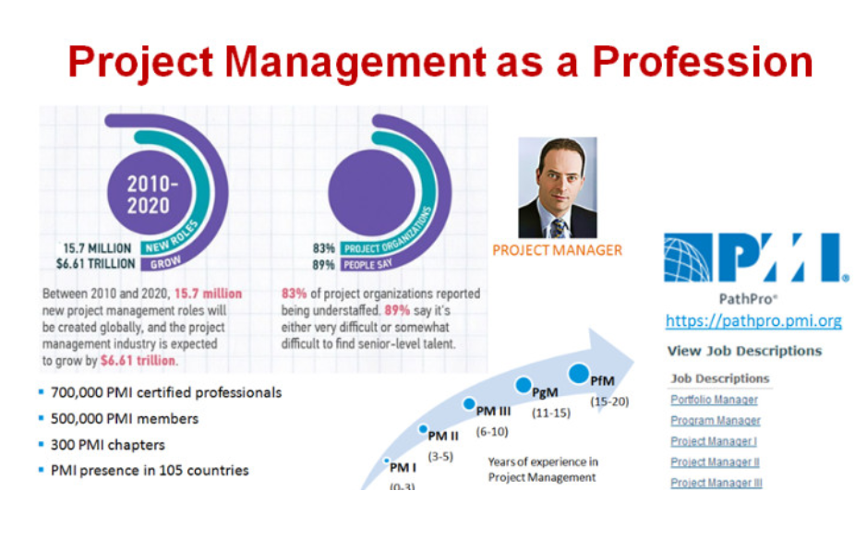

Slide 30
The project management profession is also growing in demand.
As businesses and organizations become more complex, the need for skilled project managers increases.
The following statistics demonstrate the significance of project management in today’s society, especially for projects involving information technology (IT):
Worldwide IT spending was $3.5 trillion in 2017, a 2.4 percent increase from 2016 spending. Communications services accounted for 40 percent of the spending.
The Project Management Institute reported that the number of project-related jobs reached almost 66 million in 2017, and demand continues to increase. “By 2027, employers will need 87.7 million individuals working in project management–oriented roles.”

Slide 31
The unemployment rate for IT professionals is generally half the rate of the overall labor market in the United States. The U.S. Bureau of Labor Statistics estimates the rate to be only 2 percent, and project management is one of the ten hottest tech skills.
In 2017, the average annual salary (without bonuses) for someone in the project management profession was $112,00 per year in the United States and $130,866 in Switzerland, the highest-paid country. Salaries of survey respondents across 37 counties were 23 percent higher for those with the Project Management Professional (PMP®) credential than those without it.
The top skills employers look for in new college graduates are all related to project management: team work, decision-making, problem-solving, and Verbal communication.
Organizations waste $97 million for every $1 billion spent on projects, according to PMI’s Pulse of the Profession® report. Excelling at project management definitely affects the bottom line.

Slide 32
The complexity and importance of IT projects, which involve using hardware, software, and networks to create a product, service, or result, have evolved dramatically.
Today’s companies, governments, and nonprofit organizations are recognizing that to be successful, they need to use modern project management techniques, especially for IT projects.
Individuals are realizing that to remain competitive in the workplace, they must develop skills to become good project team members and project managers. They also realize that many of the concepts of project management will help them in their everyday lives as they work with people and technology on a day-to-day basis.

Slide 33
If you are interested in a career in project management, there are a few things you can do to prepare.
First, you should obtain the necessary education and training. There are many project management courses and programs available, both online and in person.
You should also gain experience by working on projects in your current job or by volunteering.
Finally, you should obtain a project management certification, such as the PMP certification offered by the PMI.

Slide 34


